Slide 1

Module 6: Architectural Design
Part II
Software Engineering
School of Computing, Faculty of Engineering
Universiti Teknologi Malaysia

Slide 2
Architectural design decision

Slide 3
Architectural Design Decision
Architectural design is a creative process, so the process differs depending on the type of system being developed
However, a number of common decisions span all design processes and these decisions affect the non-functional characteristics of the system

Slide 4
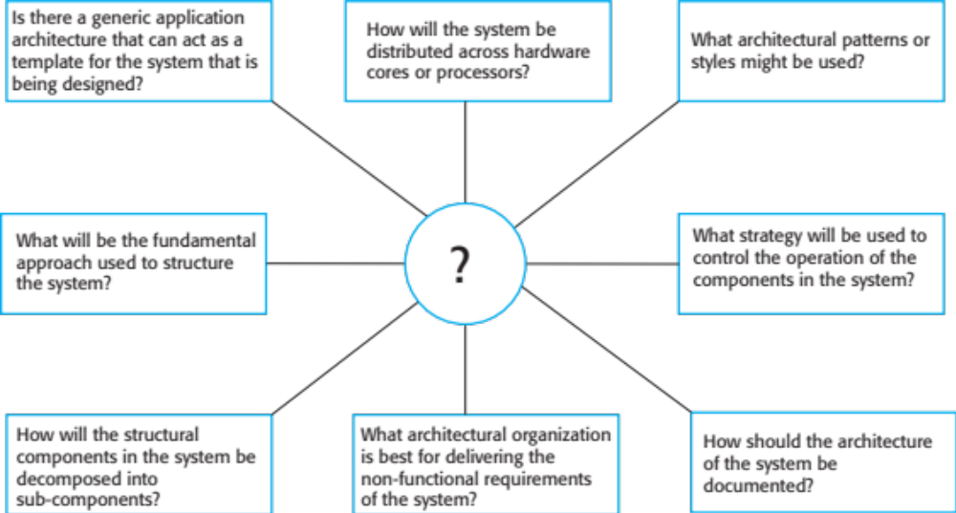
Architectural Design Decision

Slide 5
Architecture Reuse
Systems in the same domain often have similar architectures that reflect domain concepts
Application product lines are built around a core architecture with variants that satisfy particular customer requirements
The architecture of a system may be designed around one of more architectural patterns or ‘styles’ to capture the essence of an architecture and can be instantiated in different ways

Slide 6
Architecture and System Characteristics (Non-Functional Requirements)
Performance
  Localise critical operations and minimise communications
  Use large rather than fine-grain components
Security
  Use a layered architecture with critical assets in the inner layers
Safety
  Localise safety-critical features in a small number of sub-systems
Availability
  Include redundant components and mechanisms for fault tolerance
Maintainability
  Use fine-grain, replaceable components

Slide 7
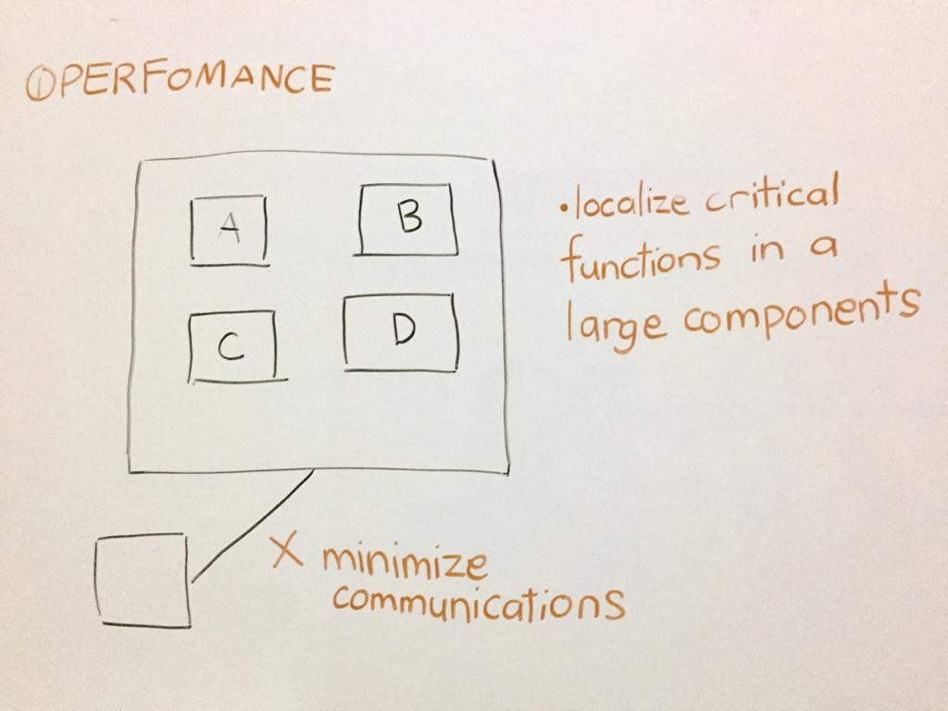
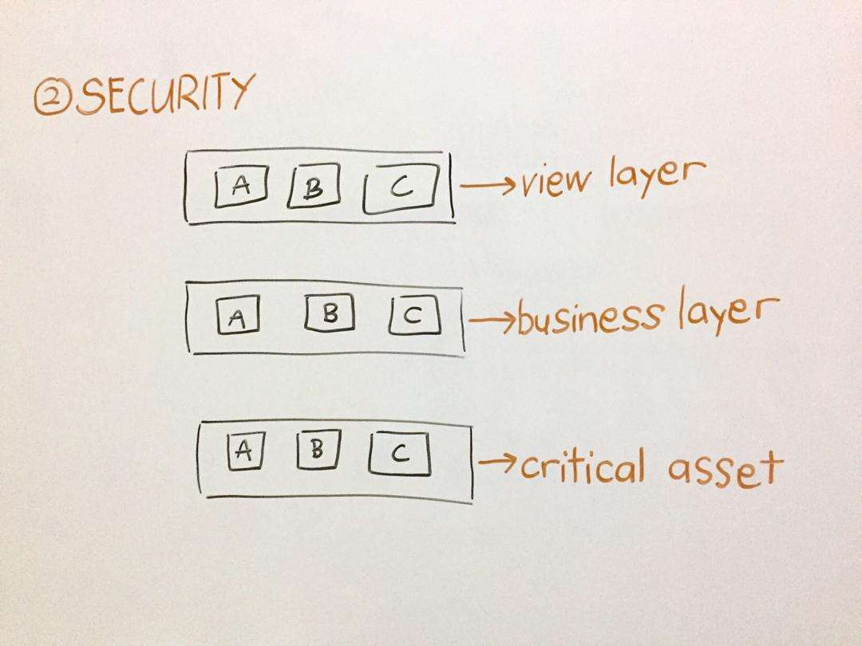
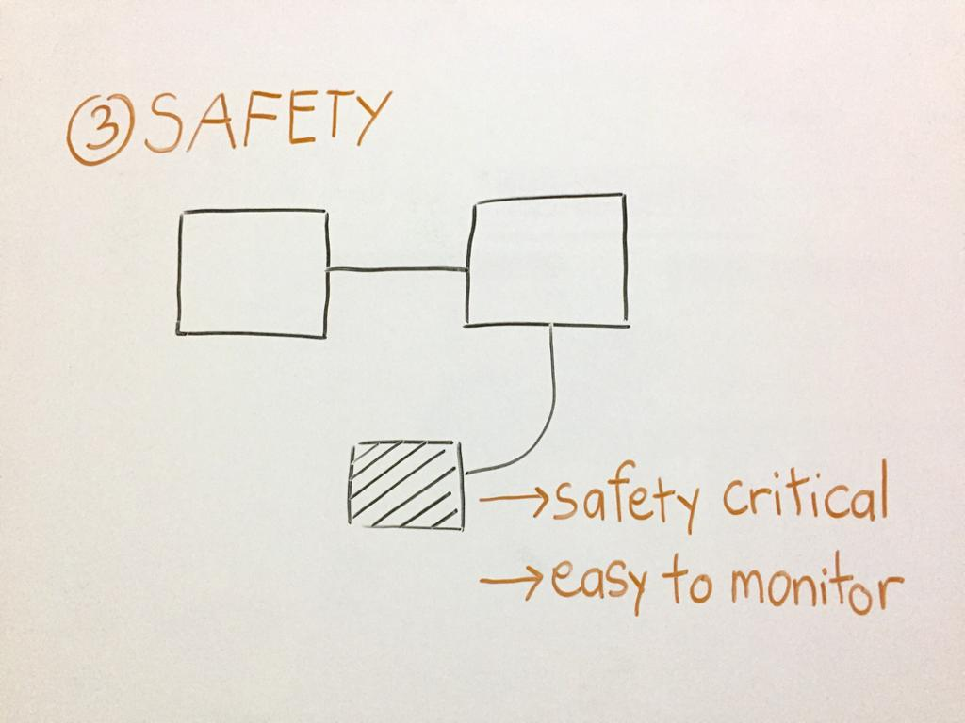
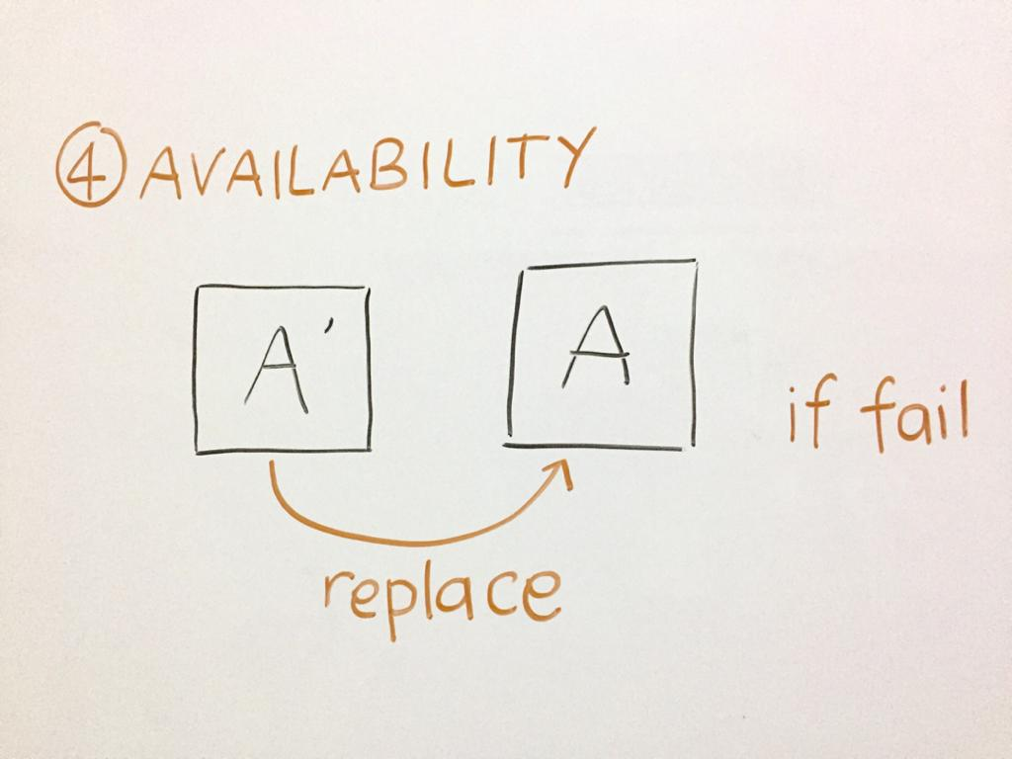
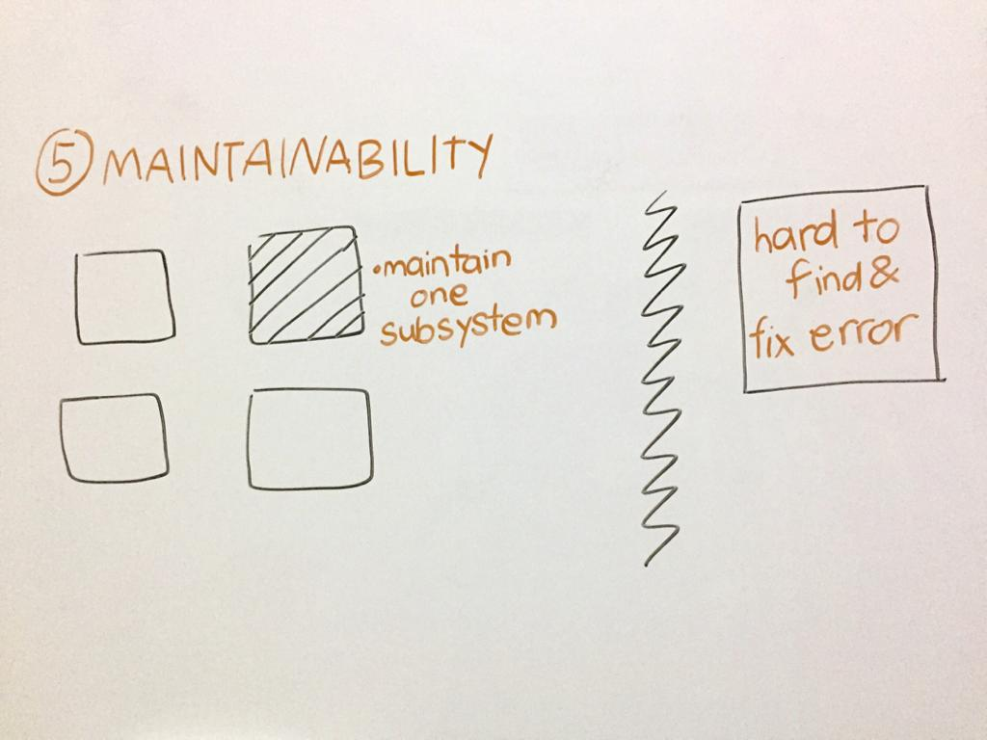

Slide 8
Architectural view
4+1 View Model

Slide 9
Architectural Views
What views or perspectives are useful when designing and documenting a system’s architecture?
What notations should be used for describing architectural models?
Each architectural model only shows one view or perspective of the system
  It might show how a system is decomposed into modules, how the run-time processes interact or the different ways in which system components are distributed across a network
  For both design and documentation, we usually need to present multiple views of the software architecture

Slide 10
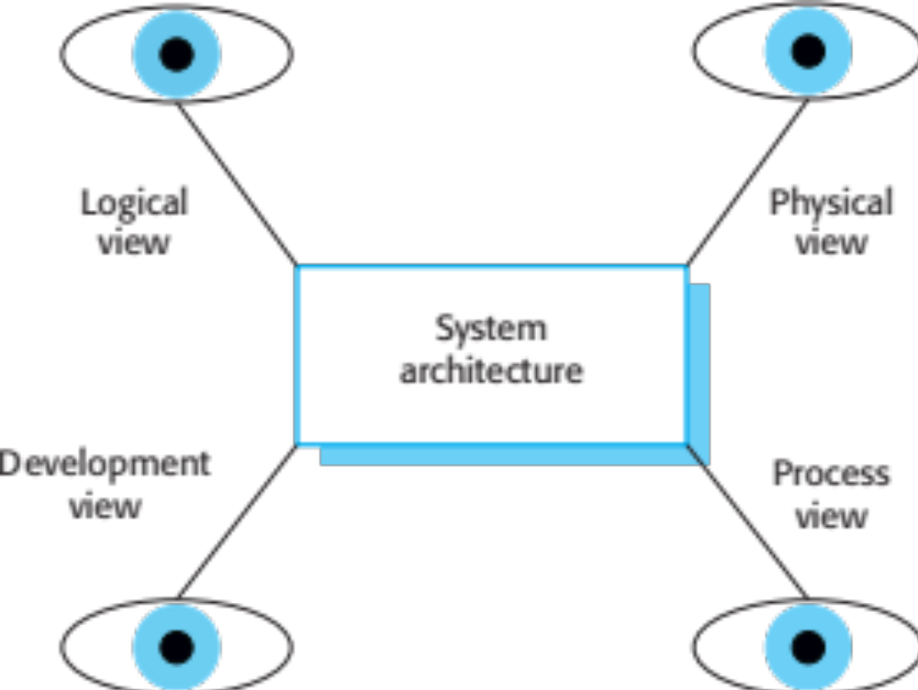
Architectural Views

Slide 11
4 + 1 View Model of Software Architecture
Logical view shows the key abstractions in the system as objects or object classes
Process view shows how, at run-time, the system is composed of interacting processes
Development (or implementation) view shows how the software is decomposed for development
Physical (or deployment) view shows the system hardware and how software components are distributed across the processors in the system
Related using use cases or scenarios (+1)

Slide 12
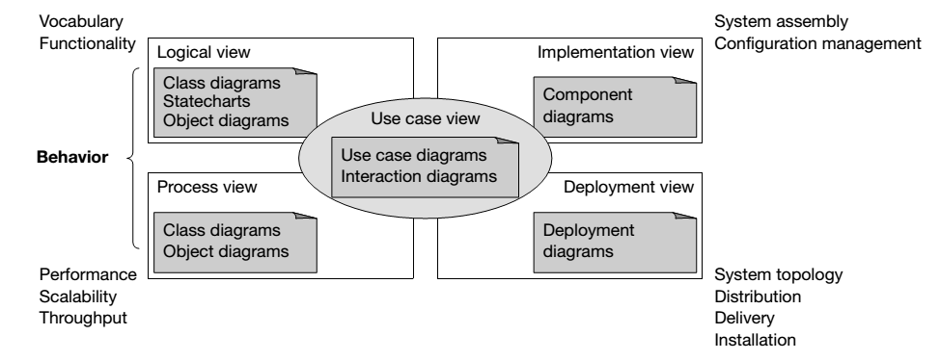
UML Diagrams to Represent Architectural Views (4+1 View Model)
Source: Kruchten (2000) in Arlow and Neustadt (2002)
Note: Sommerville (2016) states implementation view as development view, while deployment view as physical view

Slide 13
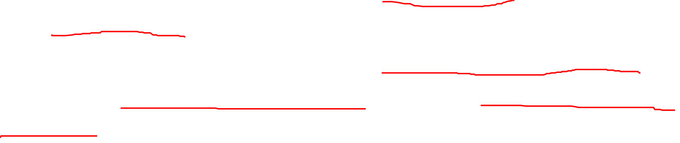
From Design to Implementation
The key artefact of the implementation workflow from the point of view of the OO analyst or designer is the implementation model
This model consists of 2 types of diagram:
  Component diagram: models the dependencies between the software components that constitute the system
  Deployment diagram: models the physical computational nodes on which the software will be deployed, and the relationships between those nodes
Source: Arlow and Neustadt (2002)

Slide 14
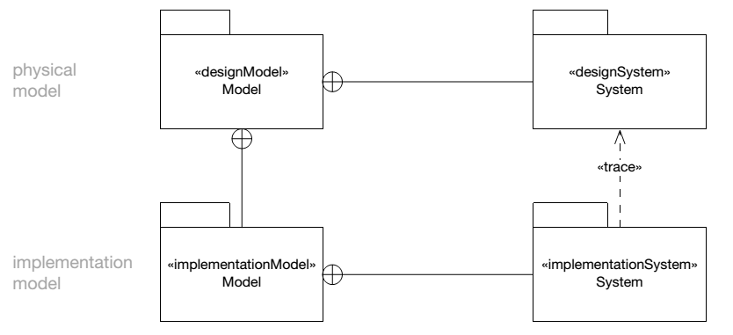
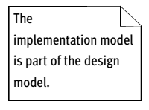
Relationship between Implementation Model and Design Model
Implementation model is really just the implementation view of a design model i.e. it is part of the design model, see the relationship <<trace>>

Slide 15
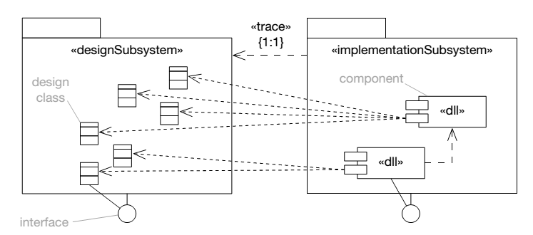
Relationship between Design Subsystems and Implementation Subsystems
There is a one-to-one «trace» relationship between design subsystems and implementation subsystems
Design subsystems contain design classes but implementation subsystems contain components that package those classes

